Slide 1
Online Ticket Reservation
By-Ashish verma soni (RA1911042010102)
mohd. Areeb iqbal (RA1911042010095)

Slide 2
Introduction
An Online Ticket Reservation is a software you can use for managing reservations for your service. An Online Ticket Reservation System allows to accept bookings online and in-person bookings with ease.
Basically, an online reservation system allows a potential customer to book Tickets.The Ticket reservation system facilitates the passengers to enquire about the trains available on the basis of source and destination, booking and cancellation of tickets, enquire about the status of the booked ticket, etc.

Slide 3
Languages Used:-
- HTML
-CSS
-PHP
-Javascript
-MySql

Slide 4
Objective
To make ticket reservations convenient and easy through a simple website.
Customers today expect instant gratification, and an online reservation system can help you provide it. Nobody in this day and age has the patience to wait at the front desk! Booking software can help you manage your waitlist. No more long queues at the front desk or having to say "one moment" to a customer waiting for you to get off the phone again! Avoid confusions that come with bookings, and automate everything with booking software with a waitlist management feature.

Slide 5
Features:
1) Searching of data is easy.
2) Passengers don’t have to wait for a long time.
3) Information is accurate.
4) It is a fast process.
5) Data efficiency is more.

Slide 6
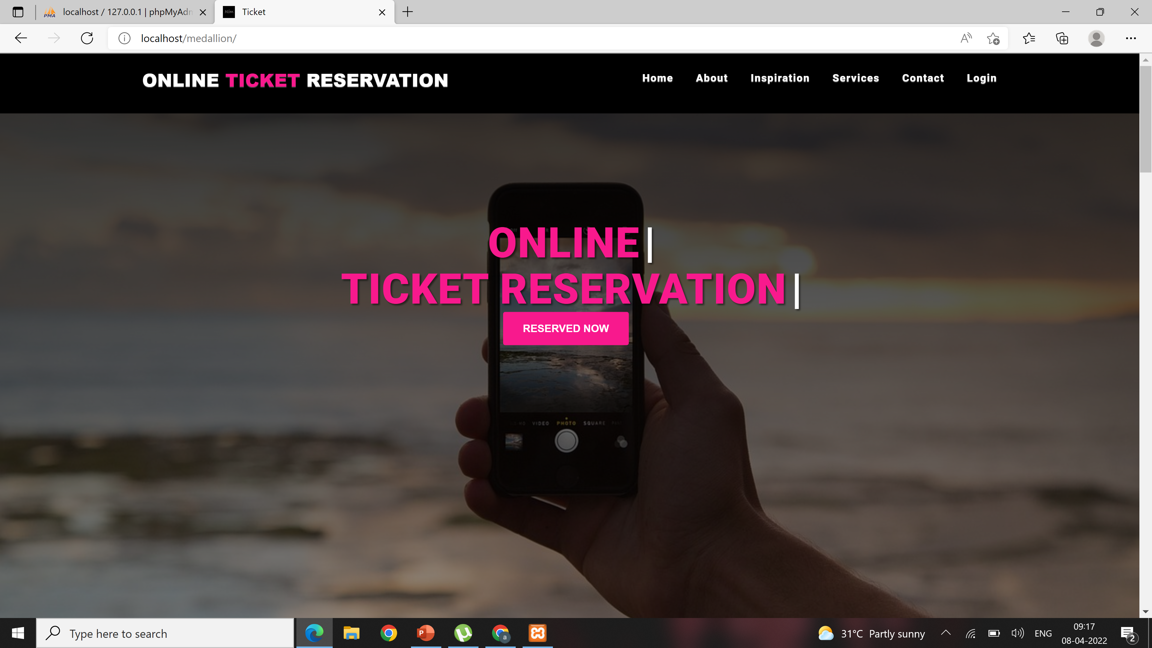
Home Page

Slide 7
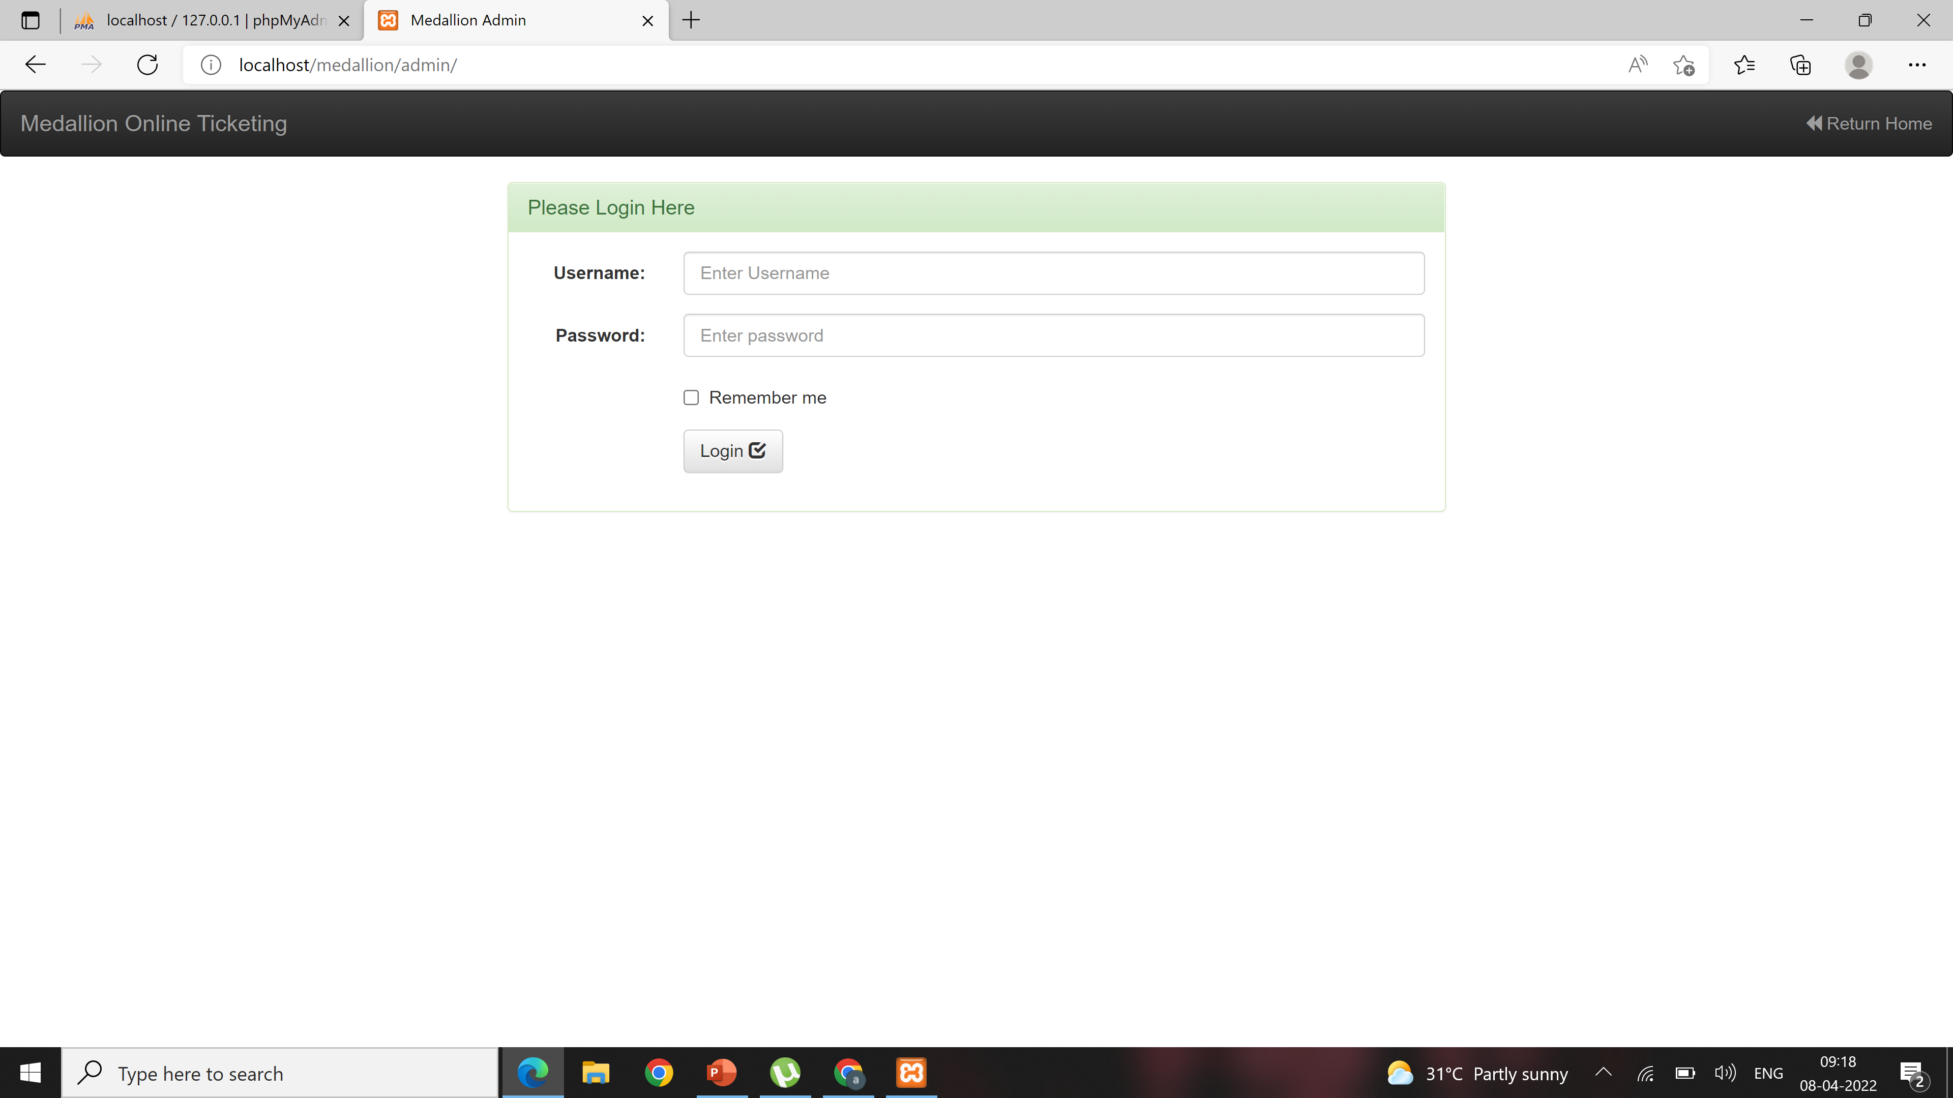
Admin Login:-

Slide 8
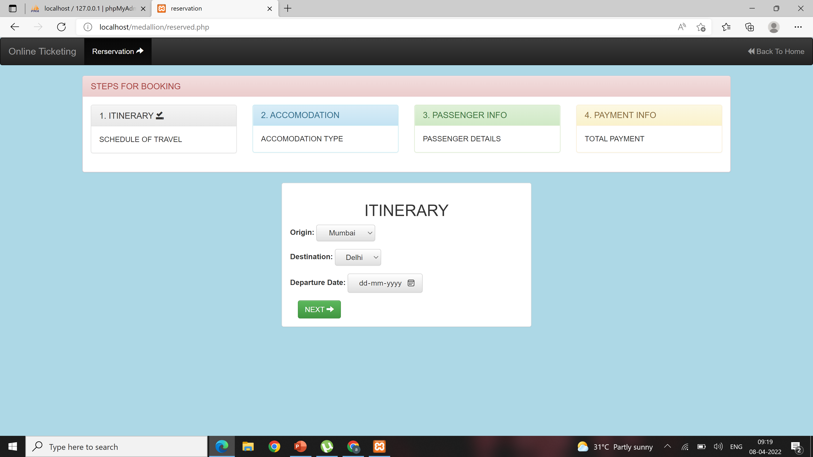
Reservation Page:-

Slide 9
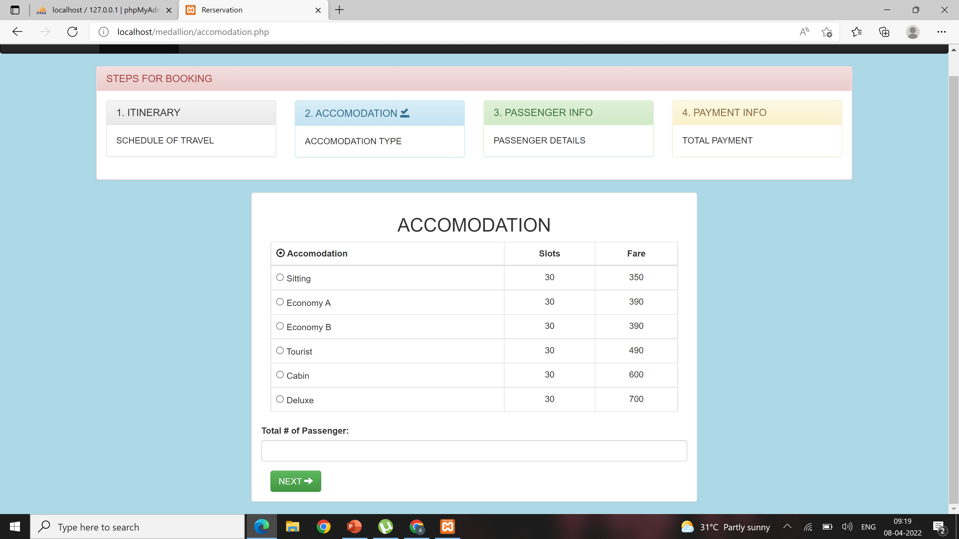
Accomodation Page:-

Slide 10
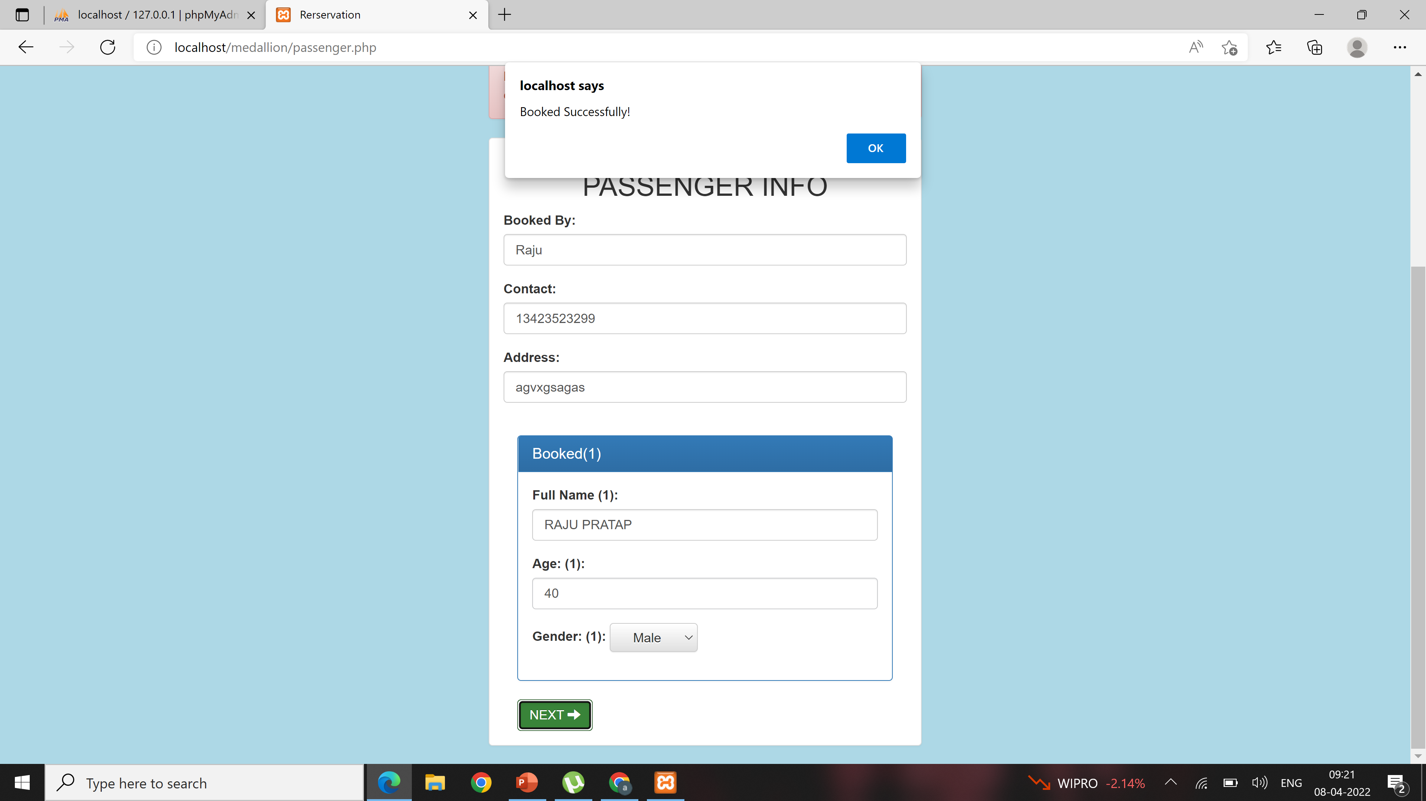
Passenger Info:-

Slide 11
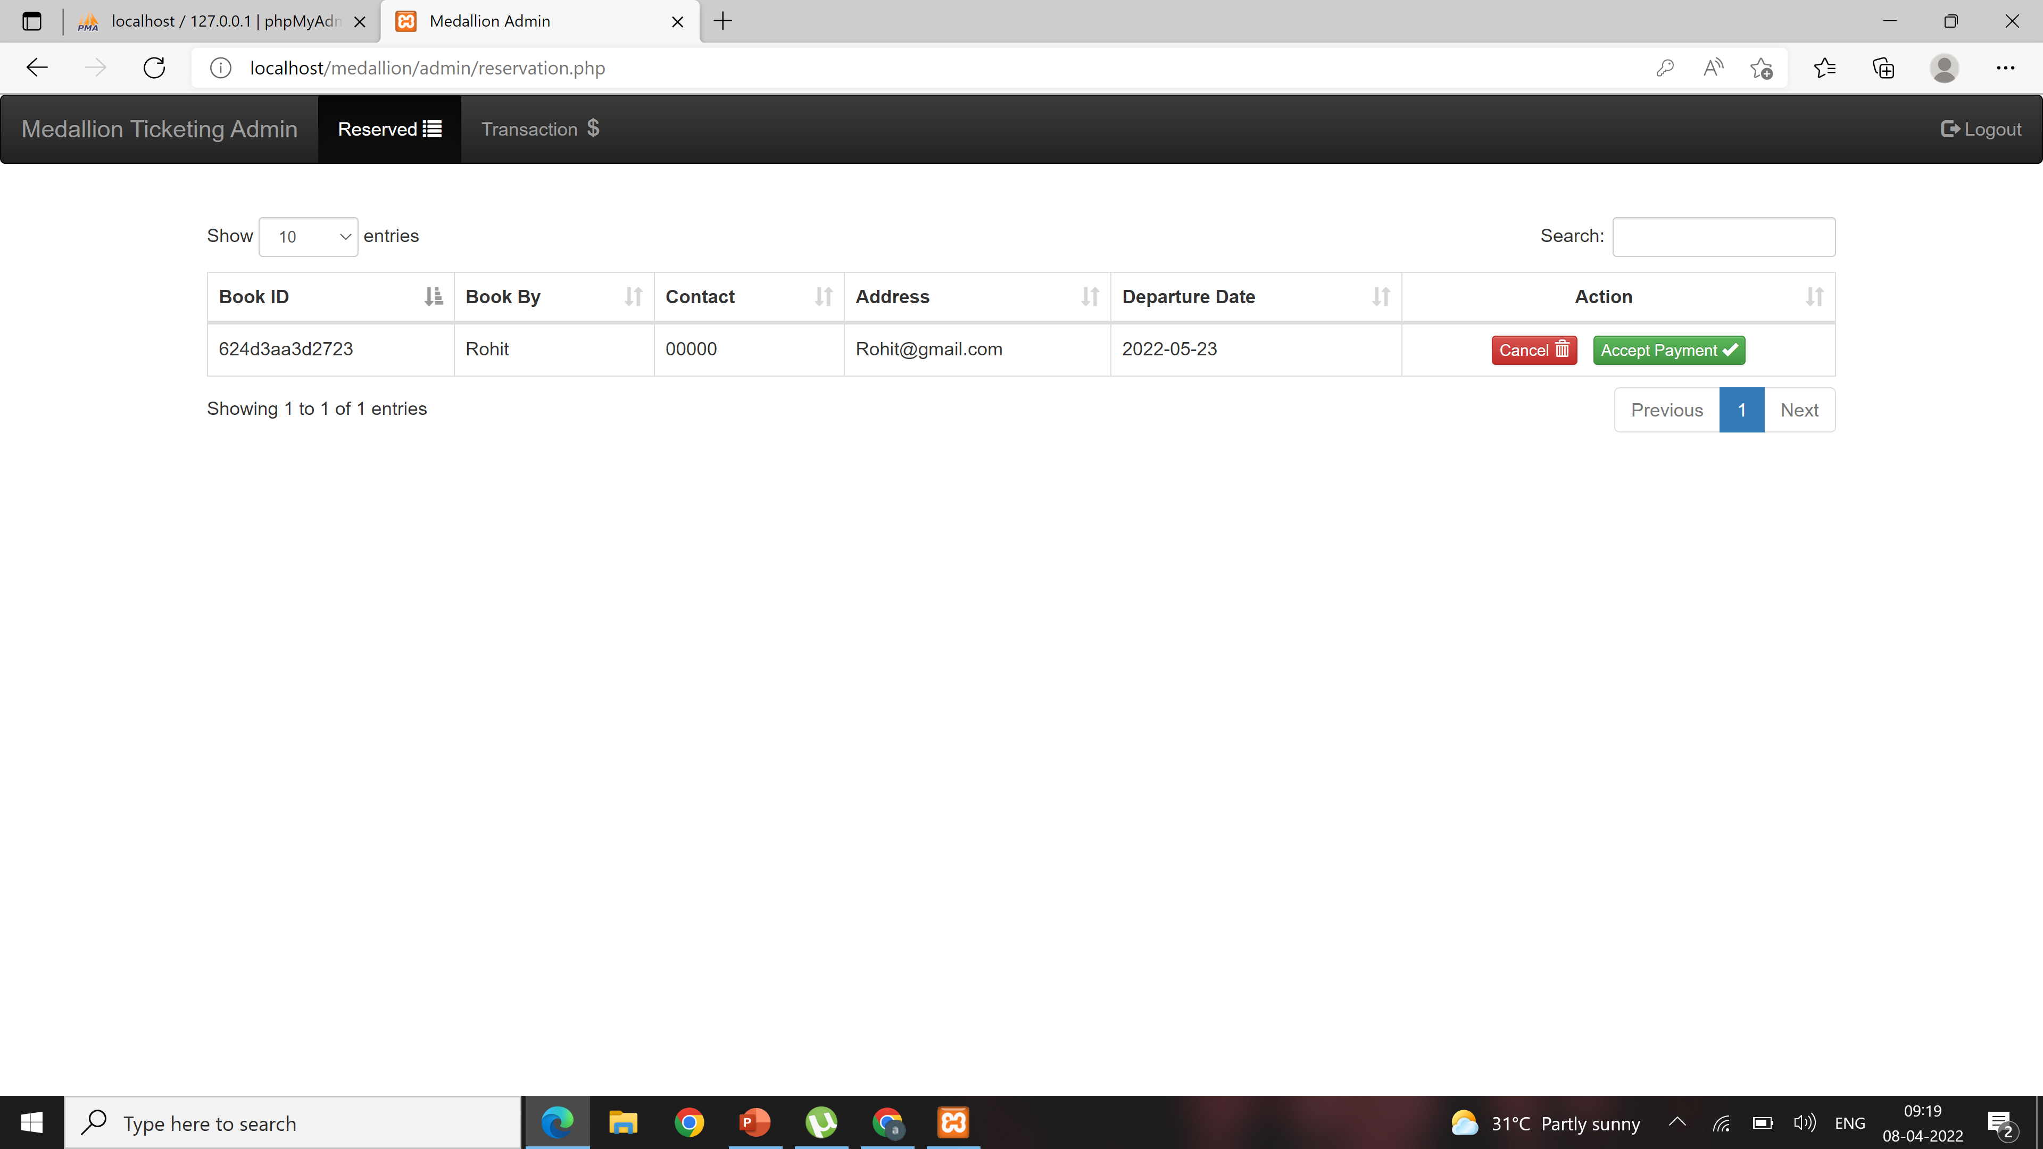
Booked info/cancellation:-

Slide 12
Conclusion:-
In our project Ticket reservation system we have stored all the information about the Trains scheduled and the users booking tickets and even status of trains, seats etc. This data base is helpful for the applications which facilitate passengers to book the train tickets and check the details of trains and their status from their place itself it avoids inconviniences of going to railway station for each and every query they get. We had considered the most important requriments only, many more features and details cand be added to our project inorder to obtain even more user friendly applications. These applications are already in progress and in future they can be upgraded and may become part of amazing technology.

